Slide 1


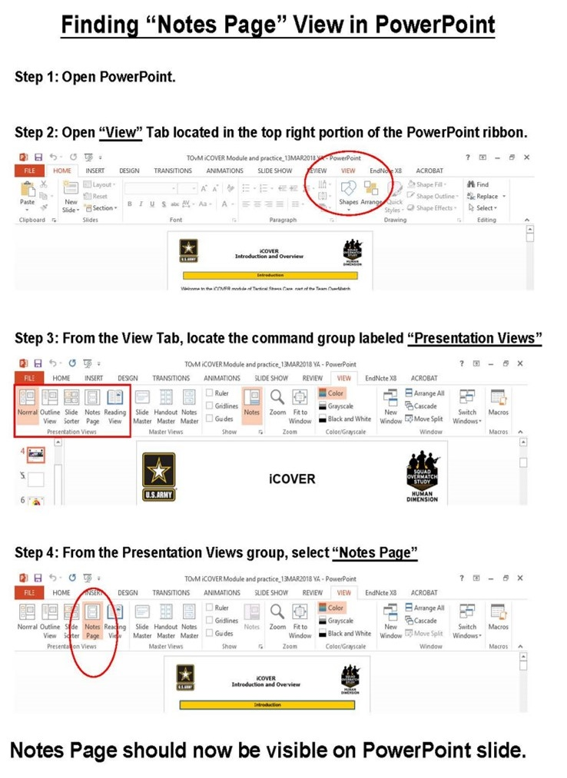
Facilitator Guide: Trainer notes
Notes:
Ask, Care, Escort
Suicide Prevention Training
Active Listening Module
for Circle of Support
ACE Base +1
September 2023
VERSION 1.3
INSTRUCTOR GUIDE

Slide 2
(Hidden)
Notes:
i-A

Slide 3
(Hidden)
Notes:
i-B
Introduction
The Army Suicide Prevention Program was instituted by CSA General John A. Wickham in 1984. Since that time, suicide prevention and awareness has evolved. In 2009, Ask, Care, Escort (ACE) training was introduced to update existing suicide prevention training and to respond to a rise in suicide rates.
ACE training introduced suicide prevention and intervention concepts that had proven successful outside of the Army. Its primary goals were to increase suicide awareness and improve the ability of Soldiers to identify team members who may be suicidal and get them to help.
In 2018, ACE training was updated to highlight its use not only during a crisis, but also before one occurs by incorporating Army team building and unit cohesion concepts. This training is aligned with the Center for Disease Control and Prevention's strategic comprehensive public health approach to suicide prevention.
In 2022, the ACE suicide prevention and intervention material was updated yet again and coined ACE Base + 1. The training now consists of a base module along with a menu of “+1” modules that the unit’s command team can choose from based upon the unit’s needs. Together, the base module and the +1 module make up the mandatory one hour of annual suicide prevention and intervention training.
In addition to the tailored training approach, the training is now designed to be more interactive and conversational. In contrast to a traditional “annual briefing,” ACE Base +1 is an “annual conversation” at platoon level where Soldiers in the platoon are able to discuss how they can take care of one another on a human level as it pertains to suicide prevention and intervention.
In 2023, the Army’s suicide prevention and intervention training expanded to include a tailored curriculum for the Soldiers’ Circle of Support members and DA Civilians. A Soldier’s Circle of Support includes anyone whom the Soldier considers to be a priority within their support system, such as a spouse, significant other, parent, sibling, other family member, mentor, and friend. The intent is that offering Circle of Support members the same knowledge and skills while using the same language and strategies can enable conversation between the Circle of Support member(s) and the Soldier regarding suicide prevention and intervention. What’s more, it can promote effective communication, bolster protective factors like increased cohesion and connection, and increase suicide prevention efforts within the whole Army Family.
ACE Training for Circle of Support- Active Listening Module
Material has been reviewed by the Walter Reed Army Institute of Research. There is no objection to its presentation and/or publication. The opinions or assertions contained herein are the private views of the author, and are not to be construed as official, or as reflecting true views of the Department of the Army or the Department of Defense

Slide 4
(Hidden)
Notes:
ii-A
Cohesive efforts: This ACE module resembles the content and format of the ACE Base module for Soldiers but has been tailored for members of a Soldier’s Circle of Support (e.g., spouse, significant other, parent(s), siblings, extended family, friends, mentors). It is strongly recommended that this training be offered around the same time frame that their Soldiers receive the ACE Unit Training. According to AR 600-63, ACE suicide prevention and intervention training must be offered to Circle of Support members on an annual basis.
A majority of the examples, discussions, and activities are focused on how a Circle of Support member might apply ACE concepts with their Soldier. The Soldier-focused examples are not to discount the importance of other people (e.g., family members, friends) or relationships that participants have with others; instead, it is done intentionally to keep the training focused on similar learning concepts. Also, it is the most universally relevant focus given every participant attending is there due to having vested interest in a Soldier.
Facilitated discussion and engagement: This training is designed to be facilitated by a single instructor and delivered in an interactive, discussion-based format (rather than conventional lecture or didactic format). Because this module utilizes group interaction, it is highly recommended that it be led by an instructor who is able and willing to elicit participant engagement through facilitating meaningful discussions and practical exercises. The practical exercises are essential in allowing participants the opportunity to try out the Ask, Care, Escort process strategies in a safe, non-threatening environment and develop competence and confidence to use the strategies in real-life scenarios.
Delivered in-person to small groups: The ACE training for Circle of Support is intended to be delivered in person and it is highly recommended that this training be conducted with small groups (fewer than 40). In-person training allows for optimal engagement and also fosters relationship building amidst the participants. For example, new friendships and support networks may be established among those attending this class. There may be circumstances that warrant a virtual training option, however, in order to be realistic and inclusive to all Circle of Support members who wish to participate (e.g., Circle of Support members being geographically scattered, child-care constraints, work schedules). Trainers and command teams are advised to use their discretion to determine the best mode of delivery without compromising its value.
Intent
ACE Training for Circle of Support- Active Listening Module

Slide 5
(Hidden)
Notes:
ii-B
The mention of any non-federal entity and/or its products is not to be construed or interpreted, in any manner, as federal endorsement of that non-federal entity or its products.
Note: Each module should be trained to standard and not to time, it is most effective when time is allowed for in-depth group discussion and participation. To maximize the benefits of this training, allow for extra time for dialogue and interaction.
Training Package Components: The complete “ACE Base +1” training package consists of five PowerPoint® presentations (i.e., ACE Base, Active Listening, Fighting the Stigma, Practicing ACE, and Lethal Means) and a SmartGuide with key information to be discussed for each slide (see notes page iv for SmartGuide overview).
Training Precautions: The ACE suicide prevention and awareness training deals with sensitive information and may trigger painful memories or other issues for training participants. It is possible that someone attending the training may have experienced thoughts of suicide or may have experienced a loved one who has struggled with suicidal thoughts, ideation, or worse – died by suicide.
If you are not a chaplain or behavioral health provider, it is recommended that you have someone from the chaplain’s office or Behavioral Health Services on call during your training session. Be sure to coordinate before the training and obtain their name, title, and consent to act as an immediate resource if needed. Provide them with the date, time, and location of the training; on the day of the training, be sure to have the number(s) at which they can be reached or another plan for reaching them.
Training Requirements: The U.S. Army’s requirement for annual suicide prevention training is for Soldiers to complete one hour of training that includes the “ACE Base” module along with one of the “+1” modules, and for the Circle of Support members to be offered annual training as well.
ACE Training for Circle of Support- Active Listening Module

Slide 6
(Hidden)
Notes:
iii-A
Training Preparation:
Content: ACE Training is the U.S. Army’s annual suicide prevention training, which is mandatory for Soldiers (IAW AR 600-63) and to be made available to Circle of Support members. The material is based on the most current research and academic literature on suicide prevention and follows educational best practices. The training is designed to enable the instructor to successfully lead participants through suicide prevention concepts with interactive activities and discussions to prompt critical thinking. For the training to be most effective, it is advised that instructors review all content in advance.
When instructing, follow the content as written. Insert personal stories/examples as appropriate. Prompts are written into the SmartGuide to highlight times when personal stories/examples can be most valuable. There are many benefits of sharing a personal story or example. For instance, stories/examples can help a trainer to capture the audience’s attention, gain common ground with the audience, and engage the audience on a deeper level. Most importantly, effective use of personal stories or examples can help participants gain better contextual understanding of the material being taught.
The following guidelines can help ensure effective use of personal stories and examples. The story/example
serves a clear purpose, specifically it reinforces the training objective/content
helps participants to gain a better contextual understanding about the concepts
does not distract participants from the focus of training (e.g., be mindful of using potentially triggering or traumatizing examples/stories)
is simple, concise, and easy to follow/understand
Remember, sharing your personal stories/examples is to benefit the participant, not yourself. The story/example should highlight the content, not you as a person (e.g., avoid the mistake of making the training about yourself). Lastly, it is highly recommended that you practice your stories/examples before using them in a training session. Rehearsing the story/example can improve effective delivery, especially if the story/example is one that could be emotional for you to share.
Flow: This training module is comprised of four main sections.
ACE Training for Circle of Support- Active Listening Module

Slide 7
(Hidden)
Notes:
iii-B
Training Preparation (continued):
Language: Suicide can be an uncomfortable topic to discuss, and it can be difficult to find the words to talk about it. As researchers continue to learn more about suicide and those impacted by it, the language used continues to evolve. For example, the term “committed suicide” perpetuates the idea that suicide is a criminal act, which can be stigmatizing. Instead, consider the phrase “died by suicide” or “attempted suicide.”
Participants may unintentionally use stigmatizing language, as not everyone understands the harmful impact of these words. It is recommended that during the training, participants are allowed to use the words they feel comfortable with to promote open conversation; however, it is recommended that the instructor supports participant usage of destigmatized language and use those words themselves.
Important concepts: When Soldiers and Circle of Support members collectively implement the ACE process, use Active Listening and intentionally Fight the Stigma, it creates a culture of trust and cohesion. Consequently, a culture of trust and cohesion encourages help-seeking behavior; Soldiers and Circle of Support members know that when they need someone, other members of the Army Family (e.g., Soldiers in the unit, Circle of Support members, DA Civilians) will have their back. As the trainer, work to present the material as a facilitated discussion so the participants are learning the material but also learning from one another and potentially growing a trusted support network.
ACE Training for Circle of Support- Active Listening Module

Slide 8
(Hidden)
Notes:
iv-A
ACE Training Facilitation Strategies:
Review the SmartGuide prior to the training session. Take notes on when you may use different facilitation strategies to promote an effective learning experience for participants.
ACE Training for Circle of Support- Active Listening Module

Slide 9
(Hidden)
Notes:
iv-B
ACE Training for Circle of Support- Active Listening Module

Slide 10
(Hidden)
Notes:
v-A
ACE Training for Circle of Support- Active Listening Module

Slide 11
(Hidden)
Notes:
v-B

Slide 12
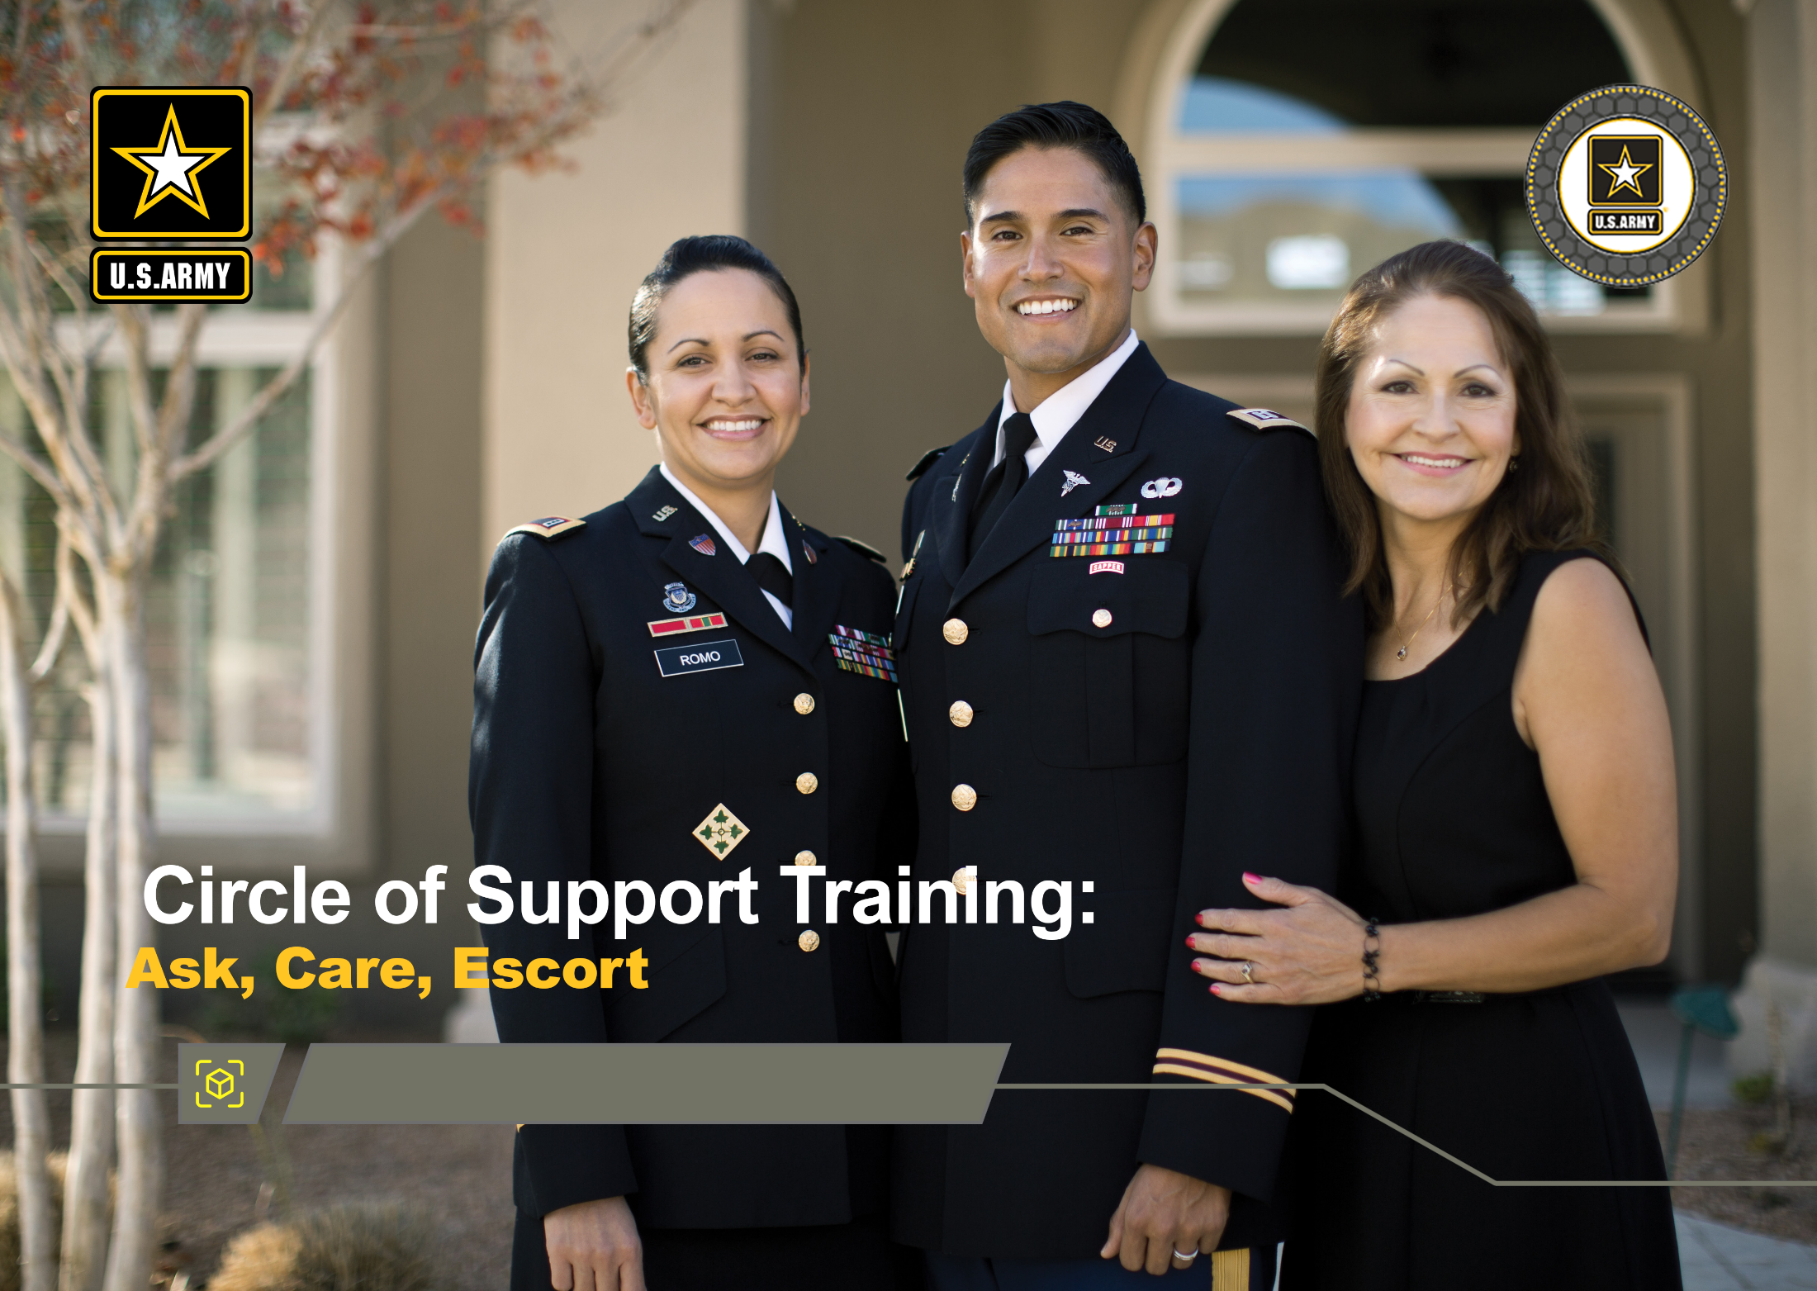



Active Listening Module
DPRR
1
Notes:
Record your own notes here:
1-A
ACE Training for Circle of Support- Active Listening Module

Slide 13
(Hidden)
Notes:
1-B

Slide 14


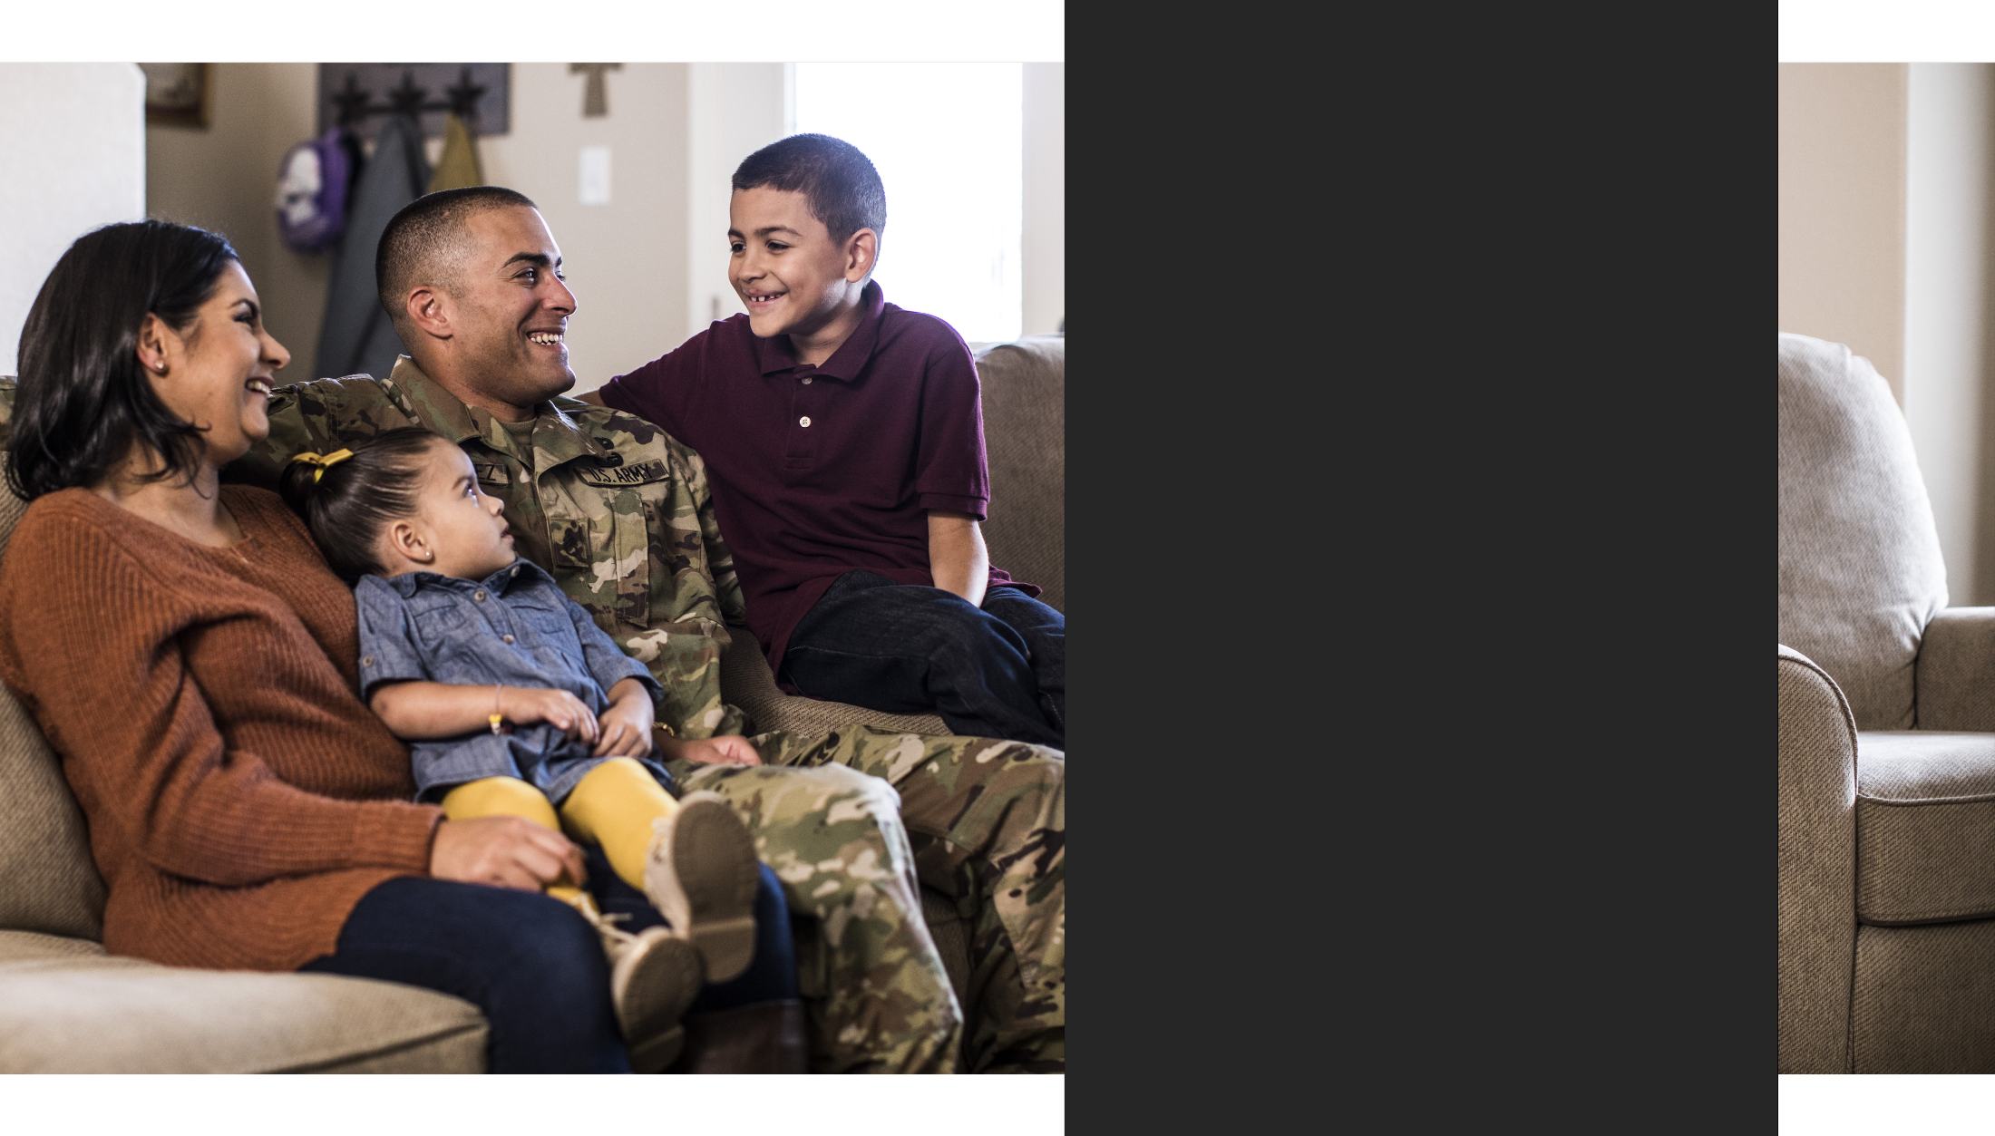
Training Purpose
Training Purpose
To enhance Circle of Support members’ understanding of the skill of active listening and how using the skill can help build strong relationships and help with suicide prevention and intervention
2
Notes:
2-A
Record your own notes here:
ACE Training for Circle of Support- Active Listening Module

Slide 15
(Hidden)
Notes:
2-B
Record your own notes here:
ACE Training for Circle of Support - Active Listening Module

Slide 16
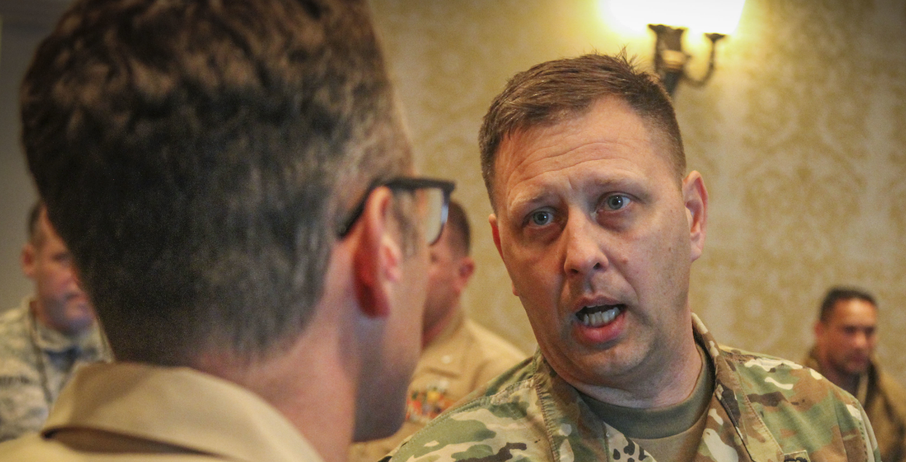
Training Purpose
What is Active Listening?
Active listening is a tool that can aid the ACE process.
Recall a time when you felt you were really listened to:
What were some behaviors that led you to feel that they were actively listening to you?
What impact did that have on you or your relationship?
Active listening encourages open communication that can build trust, connection, and cohesive relationships.
3
Notes:
3-A
[?]
Record your own notes here:
ACE Training for Circle of Support- Active Listening Module

Slide 17
(Hidden)
Notes:
3-B
Record your own notes here:
ACE Training for Circle of Support - Active Listening Module

Slide 18


Fundamentals of Active Listening: RASA
R
A
Receive
Acknowledge
S
A
Summarize
Ask
4
Notes:
4-A
Record your own notes here:
ACE Training for Circle of Support- Active Listening Module

Slide 19
(Hidden)
Notes:
4-B
Record your own notes here:
ACE Training for Circle of Support- Active Listening Module

Slide 20



RASA: Receive
R
R
RECEIVE: Give full attention and defer judgment
How can you show the speaker that you are effectively receiving the message?
Squaring up body position and making good eye contact
Resisting mentally preparing what you will say in response
Allowing the speaker to finish before asking any questions or offering your perspective
Trying to empathize with the speaker and put yourself into their shoes
Resisting interrupting with counter arguments or offering quick solutions
5
Notes:
5-A
[?]
Record your own notes here:
ACE Training for Circle of Support- Active Listening Module

Slide 21
(Hidden)
Notes:
5-B
Record your own notes here:
ACE Training for Circle of Support- Active Listening Module

Slide 22
RASA: Acknowledge
RA
A
ACKNOWLEDGE: Demonstrate you are listening by using verbal and nonverbal cues
What are some behaviors that demonstrate you acknowledge what is being said?
Be sure to nod occasionally and/or provide a thumbs up
Use facial expressions to show interest and/or concern
Be sure your posture is open and attentive
Occasionally say “I see” or “go on” to encourage conversation
6
Notes:
6-A
[?]
Record your own notes here:
ACE Training for Circle of Support- Active Listening Module

Slide 23
(Hidden)
Notes:
6-B
Record your own notes here:
ACE Training for Circle of Support- Active Listening Module

Slide 24
RASA: Summarize
RAS
S
SUMMARIZE: Taking a moment to pause and summarize what has been said by the speaker
Paraphrase concisely what has been said:
  Periodically summarize the speaker’s comments to show you are listening
  Focus on what is being said by making mental or written notes
Confirm your understanding of what has been said by repeating it back in your own words
  “What I’m hearing you say is…”
  “Sounds like you are saying…”
  “To clarify, I heard you say… is that correct?”
7
Notes:
7-A
[?]
Record your own notes here:
ACE Training for Circle of Support- Active Listening Module

Slide 25
(Hidden)
Notes:
7-B
Record your own notes here:
ACE Training for Circle of Support- Active Listening Module

Slide 26
RASA: Ask
RASA
A
ASK: Ask clarifying questions to check for understanding
What are some advantages of asking open-ended questions rather than closed-ended questions?
Ask questions to clarify the meaning of what is being said:
  “What do you mean when you say…?”
  “Help me better understand what you are saying.”
  “I don’t want to misunderstand; can you restate what you just said?”
Ask for more information:
  “I am not sure I fully understand, can you give me more information?”
  “I believe I understand what you are saying, but I need a little more information.”
8
Notes:
8-A
[?]
Record your own notes here:
ACE Training for Circle of Support- Active Listening Module

Slide 27
(Hidden)
Notes:
8-B
Record your own notes here:
ACE Training for Circle of Support- Active Listening Module

Slide 28

Prepare to Actively Listen with RASA
Fundamentals of Active Listening: RASA
R
A
KEY CONSIDERATIONS when using RASA:
Be agile. Do your best to use each step of RASA but know that you do not have to follow a specific order.
Practice makes progress. Some parts may feel natural while others may feel uncomfortable at first. Make an effort to practice each one.
Receive
Acknowledge
S
A
Summarize
Ask
9
Notes:
9-A
Record your own notes here:
ACE Training for Circle of Support- Active Listening Module

Slide 29
(Hidden)
Notes:
9-B

Slide 30
Active Listening Practical Exercise
R
A
Receive information by giving full attention
Acknowledge the speaker with eye contact and encouragement
Receive
Acknowledge
S
A
Ask clarifying questions to check for understanding
Summarize the speaker's key points
Summarize
Ask
10
Notes:
10-A
Record your own notes here:
[NOTE: If the training has an odd number of participants, then a group of 3 will be necessary. In this case, give clear direction for the third person to assume the role as Observer and take notes of sustains and improves to offer valuable feedback to the group.]
ACE Training for Circle of Support- Active Listening Module

Slide 31
(Hidden)
Notes:
10-B
Record your own notes here:
ACE Training for Circle of Support- Active Listening Module

Slide 32

Training Purpose
Debrief: Active Listening Practical Exercise
  How did it feel to incorporate active listening and the RASA fundamentals into your conversations?
  When you were in the role of Active Listener, how did using the steps of RASA help support your ability to actively listen?
  When you were in the Speaker role, what was it like to have your partner actively listening (or putting forth effort to)?
11
Notes:
11-A
[?]
Record your own notes here:
ACE Training for Circle of Support- Active Listening Module

Slide 33
(Hidden)
Notes:
11-B
Record your own notes here:
ACE Training for Circle of Support- Active Listening Module

Slide 34




Training Purpose
Active Listening to Show you CARE: Mitigate Risk
RISK FACTORS
Scenario
You notice that a close friend of yours has stopped engaging with friends and has been unresponsive your phone calls and text messages. When they do reply, they give you short answers and/or make the excuse that they “have to go”.
R
A
Receive
Acknowledge
S
A
Summarize
Ask
12
Notes:
12-A
Record your own notes here:
ACE Training for Circle of Support- Active Listening Module

Slide 35
(Hidden)
Notes:
12-B
Record your own notes here:
ACE Training for Circle of Support- Active Listening Module

Slide 36


Training Purpose
Active Listening to Show you CARE: Mitigate Risk
“Things have just been really hard lately. A lot has fallen on my shoulders, and it’s been a bit overwhelming. Some days it’s just hard to face the day.”
R
A
Receive
Acknowledge
S
A
What is an example of an open-ended question that you might ask to get more information?
Summarize
Ask
“What are some of the things that causing you to feel so overwhelmed?”
“We just had a baby last month and she’s not sleeping well at night, so neither am I. I’m enrolled in a college class and it’s a lot more work than I thought it was going to be. It’s really hard to concentrate on my homework and balance everything else too. I’m sucking at everything…even at being a friend.”
13
Notes:
13-A
[?]
Record your own notes here:
ACE Training for Circle of Support- Active Listening Module

Slide 37
(Hidden)
Notes:
13-B
Record your own notes here:
ACE Training for Circle of Support- Active Listening Module

Slide 38


The Army Values and Active Listening
R
A
Receive
Acknowledge
S
A
Army Values
Summarize
Ask
LOYALTY
Bear true faith and allegiance to the U.S. Constitution, the Army, your unit, and other Soldiers..
PERSONAL COURAGE
Face fear, danger, or adversity (physical or moral).
How could your personal or family values or the Army Values help motivate you to engage in active listening and the RASA fundamentals as it pertains to suicide prevention and intervention?
HONOR
Live up to the Army Values.
DUTY
Fulfill your obligations.
SELFLESS SERVICE
Put the welfare of the Nation, the Army, and subordinates before your own.
RESPECT
Treat people as they should be treated.
INTEGRITY
Do what’s right, legally and morally.
14
Notes:
14-A
[?]
Record your own notes here:
ACE Training for Circle of Support- Active Listening Module

Slide 39
(Hidden)
Notes:
14-B
Record your own notes here:
ACE Training for Circle of Support- Active Listening Module

Slide 40






Training Purpose
Active Listening and Suicide Prevention
How can active listening be an effective tool to lower the risk of suicide?
Lower
Suicide Risk
Improve Active Listening
Promote
Trust
Improve
Cohesion
Increase Help-Seeking
CUI
15
Notes:
15-A
[?]
Record your own notes here:
ACE Training for Circle of Support- Active Listening Module

Slide 41
(Hidden)
Notes:
15-B
Record your own notes here:
ACE Training for Circle of Support- Active Listening Module

Slide 42
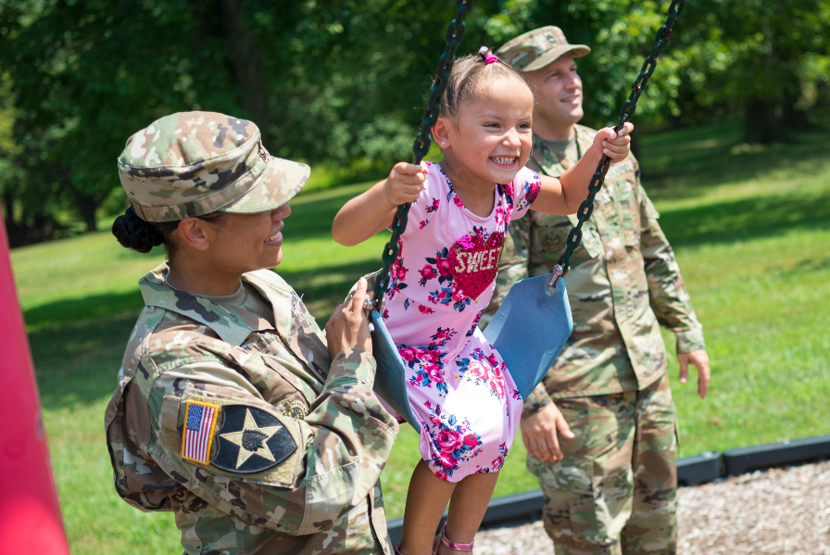
Training Purpose
Next Steps: Plan to Implement
What is one thing you plan to do within the next week or two that can help lower the risk of suicide with those in your Circle of Support?
Preventing suicide requires taking proactive steps
16
Notes:
16-A
[?]
Record your own notes here:
ACE Training for Circle of Support- Active Listening Module

Slide 43
(Hidden)
Notes:
16-B
Record your own notes here:
ACE Training for Circle of Support- Active Listening Module

Slide 44
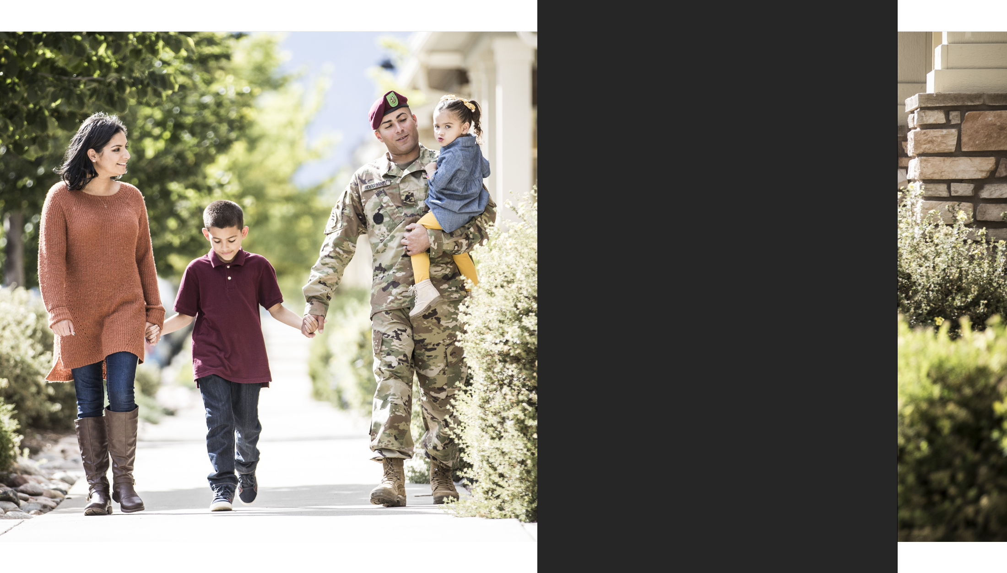
Training Purpose
Active Listening Makes an Impact
Active listening enhances communication.
Take advantage of opportunities to practice active listening and to apply a tool that can strengthen relationships at work and at home.
Active listening is a tool to effectively engage in the ACE process.
17
Notes:
17-A
Record your own notes here:
ACE Training for Circle of Support- Active Listening Module

Slide 45
(Hidden)
Notes:
17-B

Slide 46
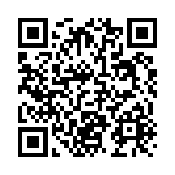
Post-Training Survey
https://wrair.gov1.qualtrics.com/jfe/form/SV_aXFrN0d3WYotIiy
Participants: You have just completed
the ACE Active Listening module.
Completing the survey will assist the DPRR in determining the effectiveness of training and will inform curriculum revisions during the next update cycle.
If you received the Base module prior to this module, please select the
Base + Active Listening option on the survey.
Notes:
Record your own notes here:
ACE Training for Circle of Support- Active Listening Module
18-A

Slide 47
(Hidden)
Notes:
18-B

Slide 48
(Hidden)
Notes:
19-A
References
Army Publications
Department of the Army. (2019). Army Leadership and the Profession (ADP 6-22).
https://armypubs.army.mil/epubs/DR_pubs/DR_a/ARN20039-ADP_6-22-001-WEB-0.pdf
Department of the Army. (2014). The Counseling Process (ATP 6-22.1).
https://caplalacaplpfwstorprod01.blob.core.usgovcloudapi.net/web/repository/doctrine/atp-6- 22x1.pdf
Department of the Army. (2015). Army Team Building (ATP 6-22.6).
https://armypubs.army.mil/epubs/DR_pubs/DR_a/pdf/web/atp6_22x6%20FINAL.pdf
Department of the Army. (2022). Developing Leaders (FM 6-22). https://armypubs.army.mil/epubs/DR_pubs/DR_a/ARN36735-FM_6-22-000-WEB-1.pdf
Department of the Army. (2015). Soldier's Guide (TC 7-21.13). https://armypubs.army.mil/epubs/DR_pubs/DR_a/pdf/web/tc7_21x13.pdf
Department of the Army. (2020). The Noncommissioned Officer Guide (TC 7-22.7).
https://armypubs.army.mil/epubs/DR_pubs/DR_a/pdf/web/ARN20340_TC%207-
22x7%20FINAL%20WEB.pdf
Other Publications
McClay, M. M., Brausch, A. M., & O'Connor, S. S. (2020). Social support mediates the association between disclosure of suicide attempt and depression, perceived burdensomeness, and thwarted belongingness. Suicide & Life-Threatening Behavior, 50(4), 884–898. https://doi.org/10.1111/sltb.12622
Rugo, K. F., Leifker, F. R., Drake-Brooks, M. M., Snell, M. B., Bryan, C. J., & Bryan, A. O. (2020). Unit cohesion and social support as protective factors against suicide risk and depression among National Guard Service Members. Journal of Social and Clinical Psychology, 39(3), 214-228. https://doi.org/10.1521/jscp.2020.39.3.214
Treasure, J. (2013). Conscious listening. Annual Meeting Proceedings. Million Dollar Round Table, 93-103. http://www.imdrt.org/mentoring/2013_Treasure.pdf
ACE Training for Circle of Support- Active Listening Module

Slide 49
(Hidden)
Notes:
19-B

